Slide 1
TRASHING FOOD WASTE WITH TECHNOLOGY
presents
Pre Activity
Proudly supported
by
www.aitc-canada.ca

Slide 2
As part of Canadian Agriculture Literacy Month you will be listening to a Canadian agriculture expert share their insight into an important topic: “Trashing Food Waste with Technology”.
This resource will help grow your knowledge of the relationship between agriculture and technology and prepare you to hear and understand what the expert has to share.
We hope that this resource will give you a solid foundation and cultivate some great discussions and questions in your classroom.

Slide 3
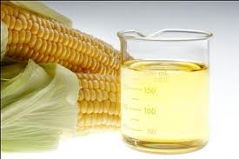
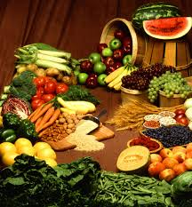
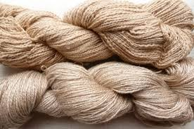
What is Agriculture?

Slide 4
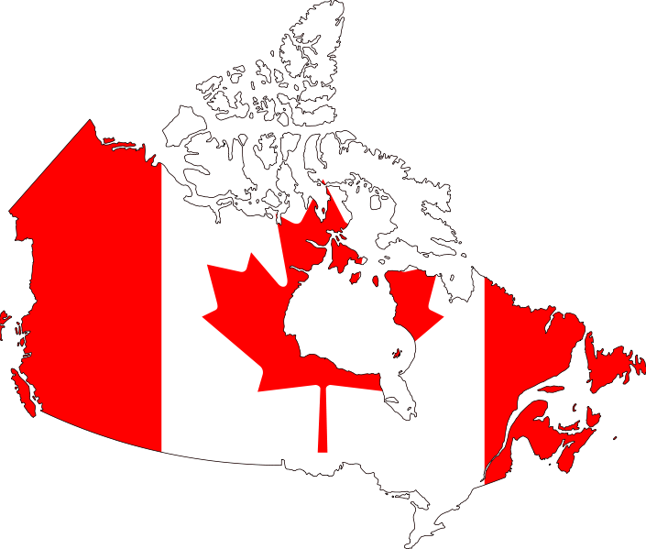
What affects what Canada Grows?

Slide 5
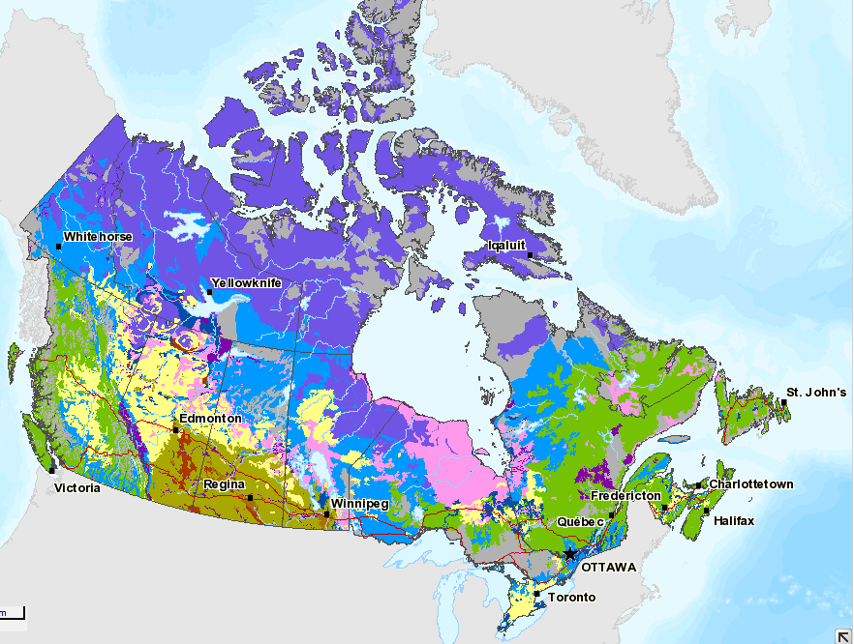
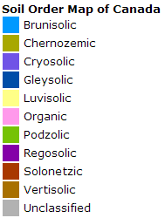
Soil
SOURCE: http://atlas.agr.gc.ca/agmaf/index_eng.html#context=soil-sol_en.xml&extent=-2806489.7150002,-789911,3431059,3641857.440138&layers=place37M,place25M,place15M,place5M,place1M,place500K,place250K;rivers25M,rivers15M,rivers5M,rivers1M,rivers500K,lakes37M,lakes25M,lakes15M,lakes5M,lakes1M,lakes500K,Roads25M,Roads15M,Roads5M,Roads1M,Roads500K,ferry500K,bndy5-37M,bndy1M,BndyLn1-5M;SoilOrder1M;
Notes:
Soil is so important when it comes to growing crops. Soils need the right balance of nutrients and ph to be good for growing food. This map shows how soil differs across the country.

Slide 6
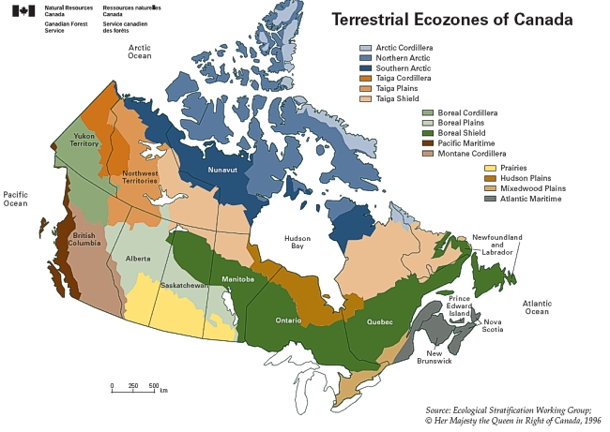
Landforms
Notes:
Landforms, something closely related to soil is another way to look at what can grow where. Notice the similarities in shapes of the graphs.

Slide 7
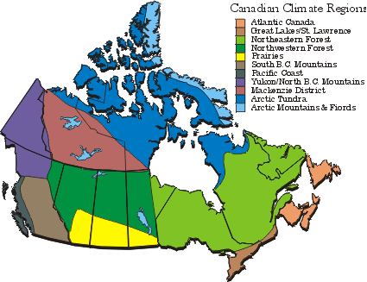
Climate
Source: https://www.ec.gc.ca/adsc-cmda/default.asp?lang=En&n=8C03D32A-1
Notes:
Of course climate is another key factor when looking at what we can grow in Canada. Temperature, precipitation, length of growing season and amount of sunlight all are key factors in growing crops. Again, see he similarities between the soil and landform maps – the soils and landforms are very closely interconnected with climate.

Slide 8
Arable Land:
land that can be used for growing crops
Source: https://www.ec.gc.ca/adsc-cmda/default.asp?lang=En&n=8C03D32A-1
Notes:
Activity:
Breaks students up into 11 groups.
Assign each group one of the climate regions.
Have each group brainstorm about each region:
1) What are some words you would use to describe the climate in this region
2) What are some words you would use to describe the soil in this region
3) Do you think that this area is arable (for the most part)
4) What do you think are the top commodities produced here and why?

Slide 9
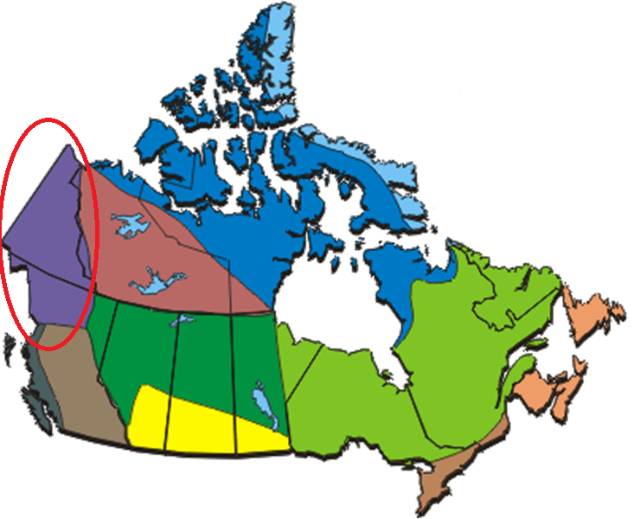
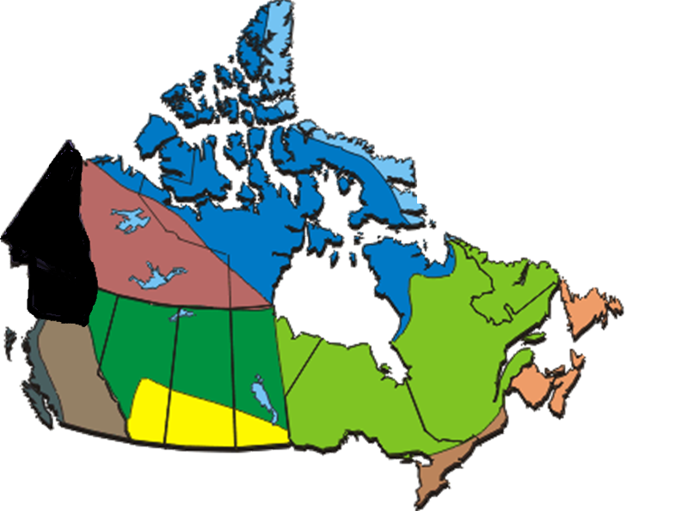
Yukon/North BC Mountains
Notes:
Talk to each group.
Yukon and North BC Mountains, once they come to their conclusions show the area with black if it is mainly not arable
Climate: Cold as it is far north, short days and short summers. Snow on ground 6-8 months
Geology: steep mountains and narrow valleys with some rolling hills and tundra to the north
Agriculture/main Commodities: very small human population that works to support themselves – not creating industry. Mining towards the south

Slide 10
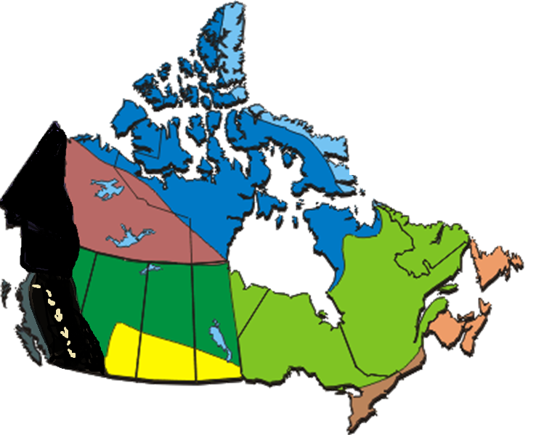
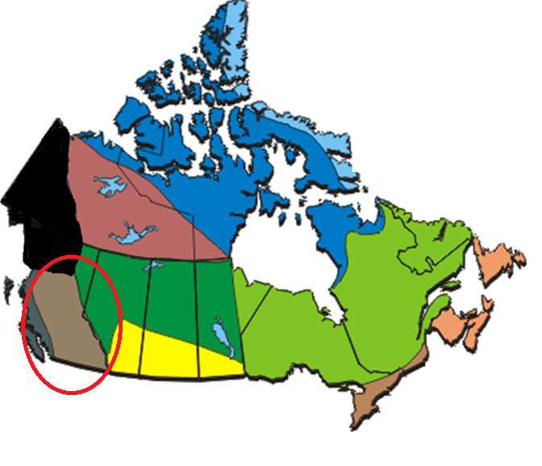
South BC Mountains
Notes:
Climate: Dry summers and wet winters with mild temperatures.
Geology: Mountains and glacial deposit from ancient lakes.
Agriculture: cattle grazing, forestry and mining
- some patches of agricultural land but not substantial

Slide 11
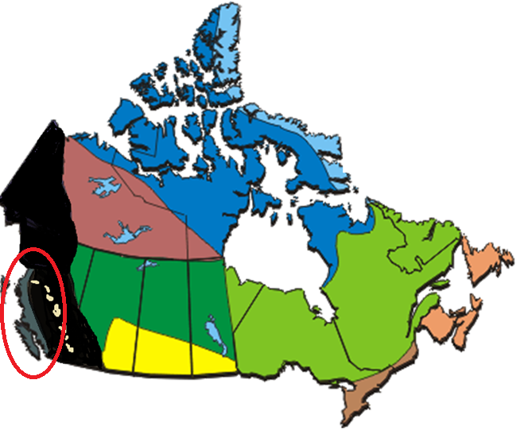
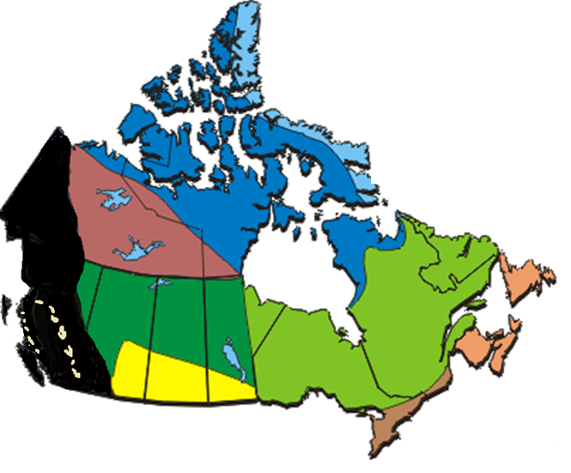
Pacific Coast
Notes:
Pacific Coast
Climate: very wet weather with cool summers and mild winters
Geology: coastal mountains, fjords and channels. Large forests and big trees. The Fraser river lowland does have productive soils
Agriculture: fruit farms are abundant in the Fraser river lowlands

Slide 12
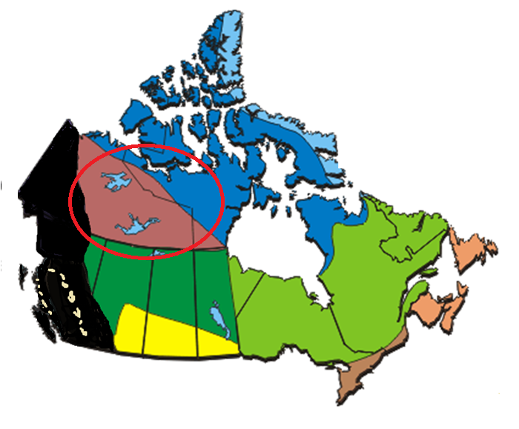
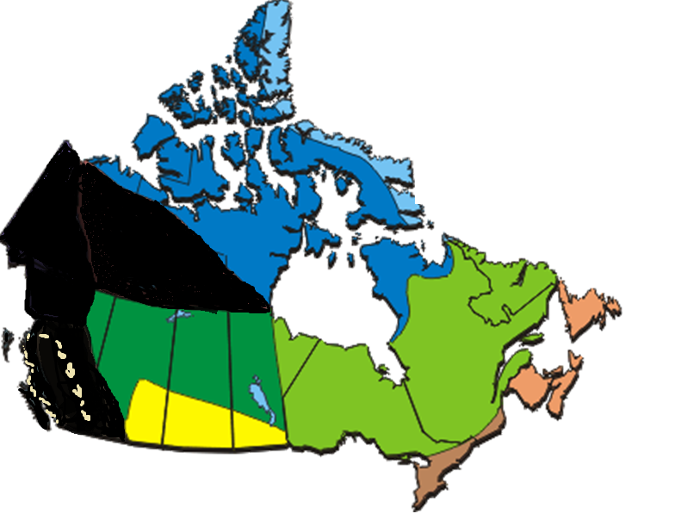
Mackenzie District
Notes:
Mackenzie District – named after the Mackenzie River
Climate: short cool summers and long cold winters with little rainfall
Geology: Sedimentary rock, limestone, canyons
Agriculture: some mining and forestry

Slide 13
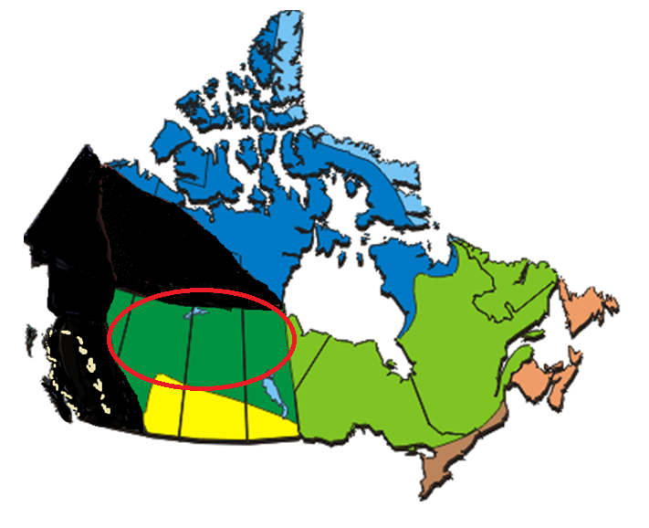
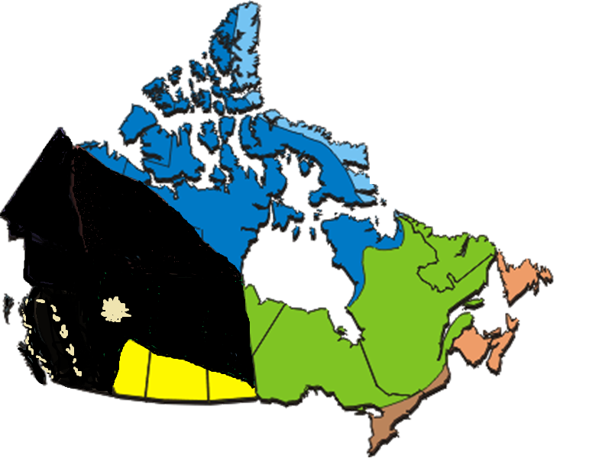
Northwestern Forest
Notes:
Northwestern Forest
Climate: short warm summers and cold winters – less precipitation due to mountains
Geology: To the west mountainous flat and to the east thick soil over bedrock
Agriculture/ Main Commodities: Natural resource deposits with oil, gas and forestry, cattle grazing with some small agricultural land extending from prairies

Slide 14
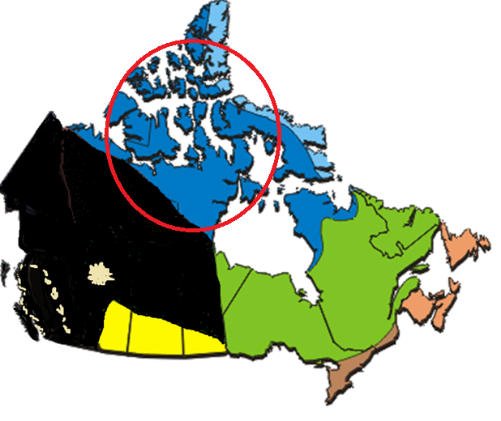
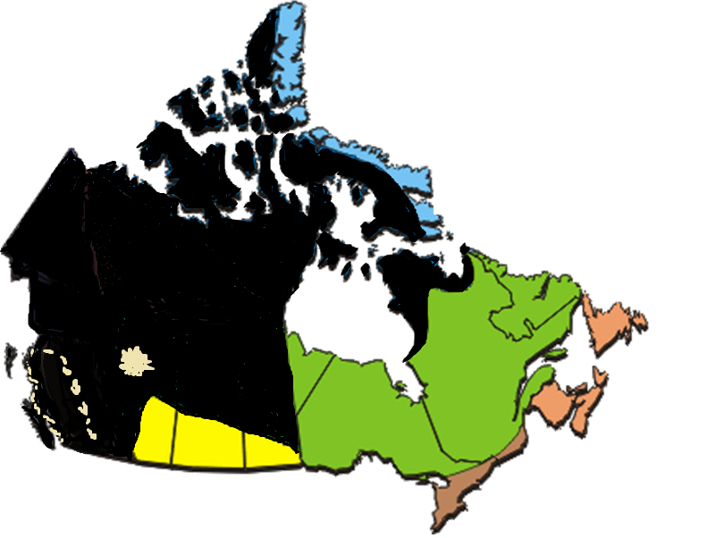
Arctic Tundra
Notes:
Arctic Tundra
Climate: coldest and driest part of Canada. Winter nights last for months
Geology: Permafrost means ground is always frozen
Agriculture: none

Slide 15
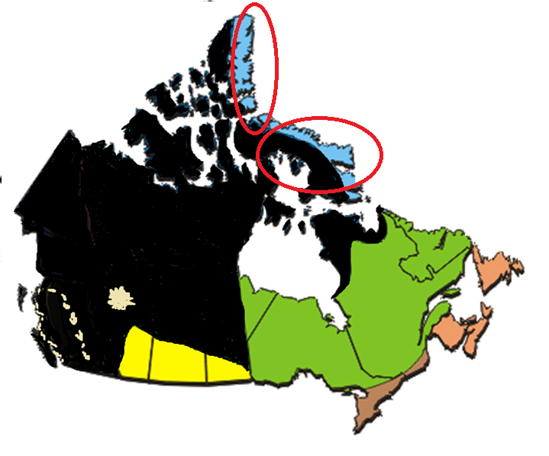
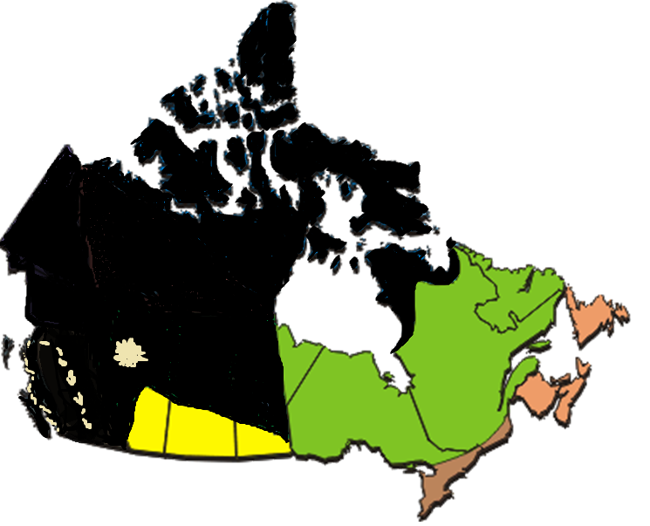
Arctic Mountains and Fiords
Notes:
Arctic Mountains and Fiords
Climate: very cold and lots of snow but long days during a short summer
Geology: large mountains and deolate valleys
Agriculture: none

Slide 16
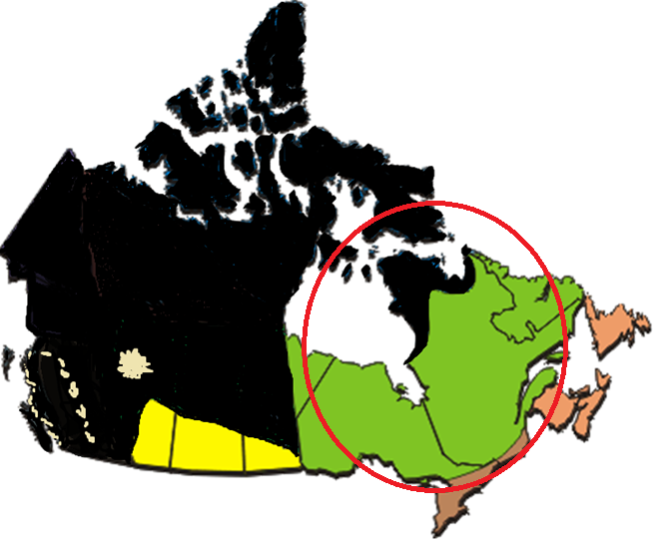
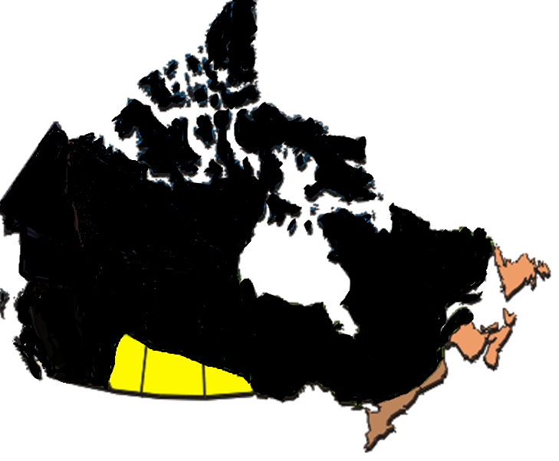
Northeastern Forest
Notes:
Northeastern Forest
Climate: lots of wetlands close to Hudson bay. Climate varies throughout with mild winters on east and cold winters on west.
Geology: flat and poor drainage means bogs and wetlands near Hudson bay with bedrock known as the Canadian Shield and thick boreal forest.
Agriculture: forestry, mining etc.

Slide 17
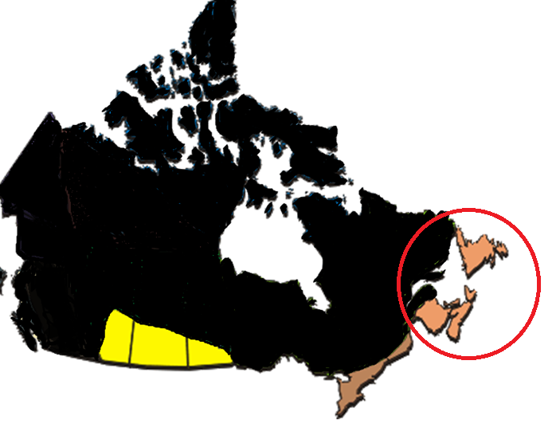
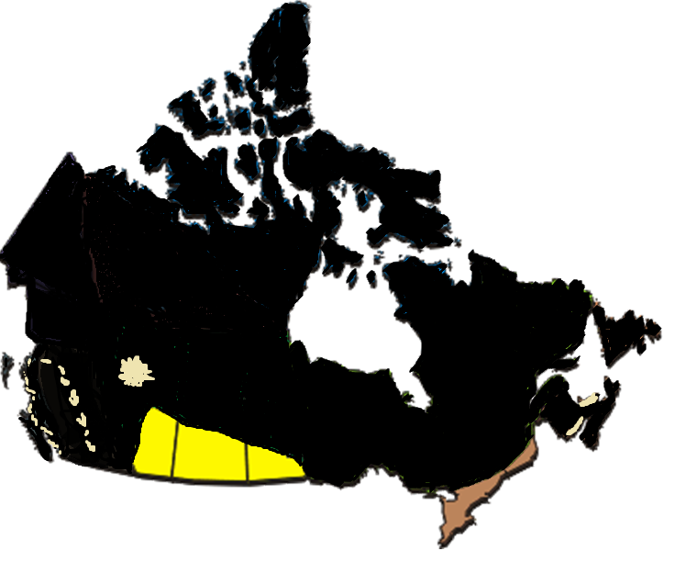
Atlantic Canada
Notes:
Atlantic
Climate: cool summers, warm winters. Heavy precipitation and lots of storms
Geology: sedimentary bedrock. Acid soils in the inland but some better soil on lowlands.
Agriculture /Main commodities: some agriculture on lowlands but inland where soil is acidic is better for forest. fishing, potatoes are main commodities

Slide 18
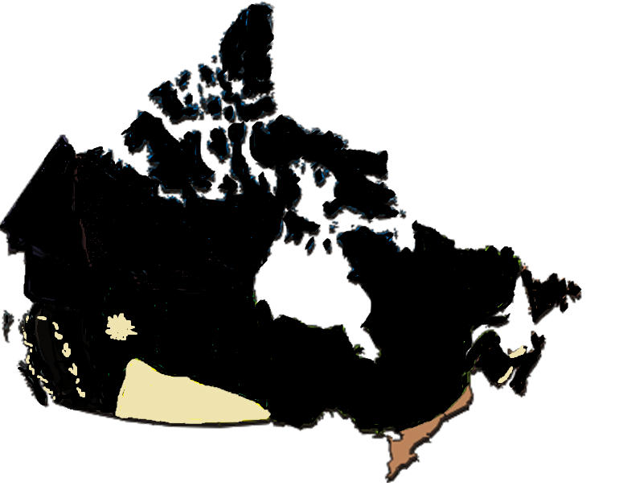
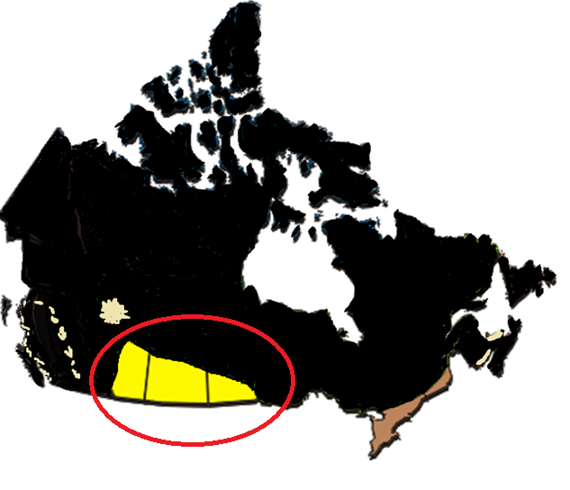
Prairies
Notes:
Climate: very dry and extreme temperatures
Geology: fertile soils mean that 95% of plains have been converted to farm land
Agriculture: Many grains and oil seeds are grown on this fertile land
Mostly beige as it is very agriculutral

Slide 19
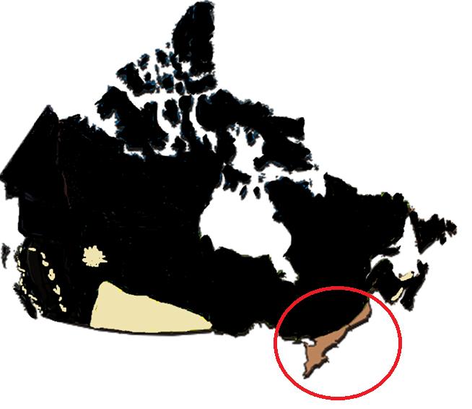
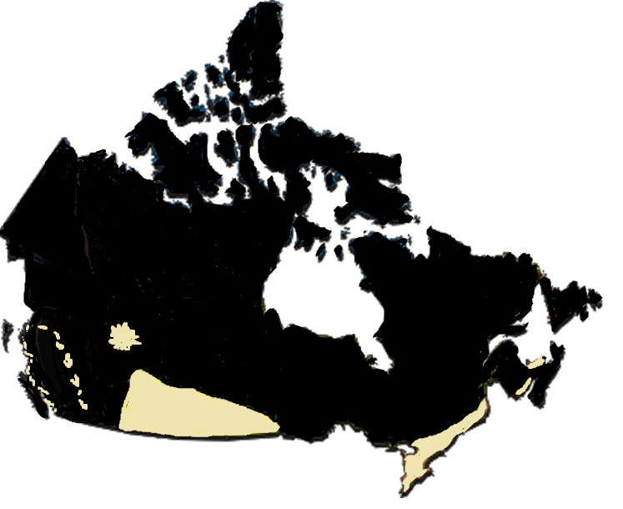
Great Lakes/St Lawrence
Notes:
Climate: cool winters and warm summers
Geology: rich agricultural soils. Many water ways and lakes
Agriculture/ Main Commodities: Very productive area agriculturally but also contains expanding cities, half of Canada’s population and high levels of pollution. very diverse, grain crops, livestock etc.
-Mostly beige for agricultural land

Slide 20
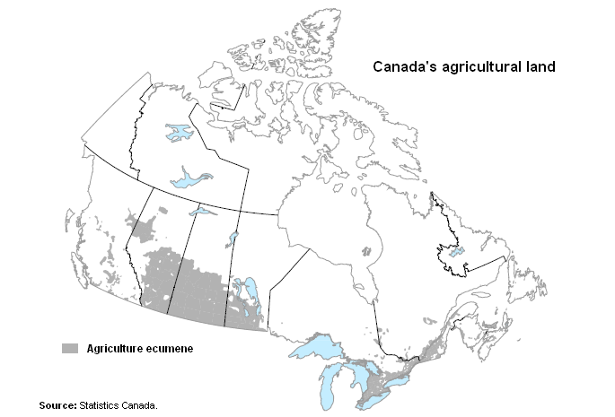
http://www41.statcan.gc.ca/2006/3119/htm/ceb3119_000_2-eng.htm
Notes:
A more accurate depiction of Canada's agricultural land. Now discuss these critical thinking questions:
How does land dictate what is produced where?
Are there some commodities that you think are more important than others? Justify your response.
Why is the way we use our agricultural land so important?
Do you think food prices vary across Canada? Across your province? Explain your reasoning.
What are the major challenges, if any, that farmers face? How could these challenges be tackled?
Should the types of farms in Ontario be more evenly distributed? Justify your response.
How does consumer demand impact what is produced in Canada?

Slide 21
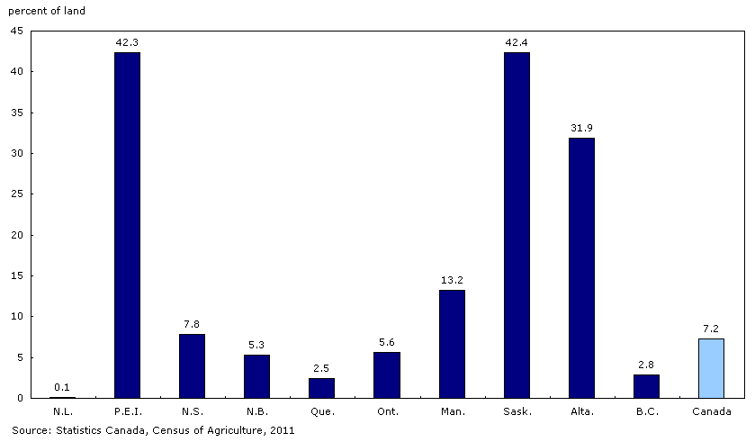
Total Farm Area as a proportion of Total Land Area
Notes:
Discussion about Land use: Ontario had some of the best agricultural land yet only 5.6% is used for farmland – why?

Slide 22
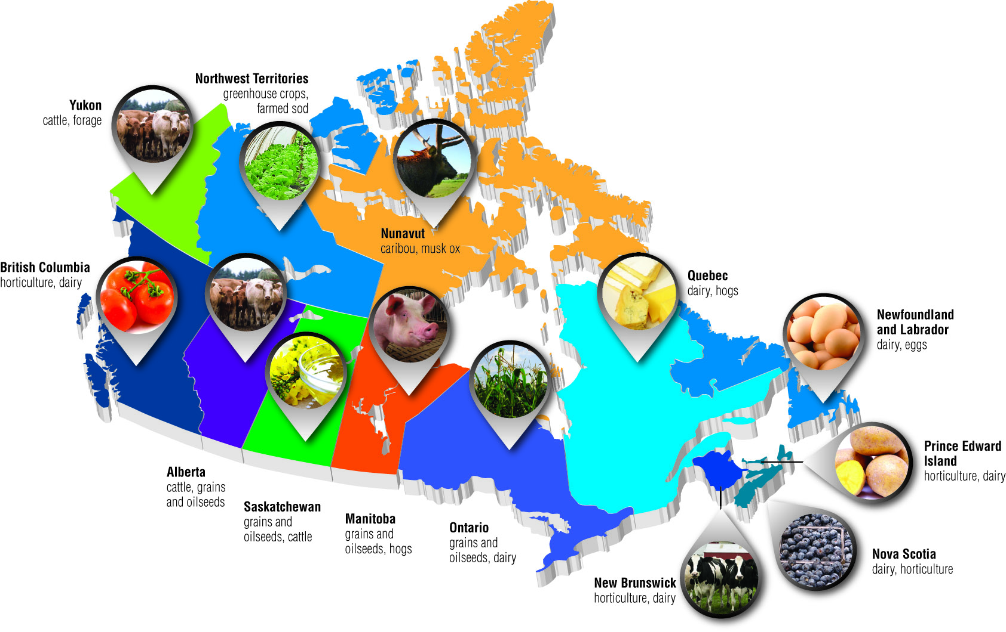
1
Notes:
Now discuss the commodities that each group guess and why some regions will produce certain crops. Notice that grains and oilseeds are in the agricultural areas with arable land. Other regions rely more heavily on livestock production. Notice that areas without good arable land and good climates for growing use greenhouses (Northwest Territories(

Slide 23
What is A GMO? What is Biotechnology?
Notes:
Ask students to define GMO and Biotechnology to assess their level of understanding and adjust teaching activities as required.

Slide 24
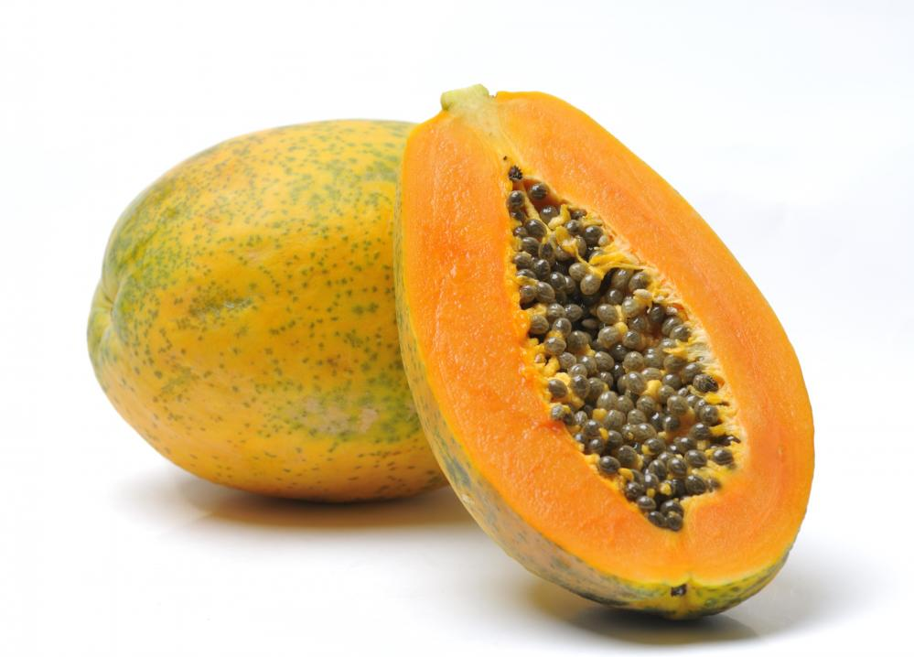
Exploring GMO’s
How GMO’s are Made: The Papaya Story
https://www.youtube.com/watch?v=2G-yUuiqIZ0
Notes:
Play the video “How GMO’s are Made: The Papaya Story” https://www.youtube.com/watch?v=2G-yUuiqIZ0
Discuss as a class the reasons GMO’s were created and what steps are taken to create GMOs. Briefly discuss bias in the video.

Slide 25
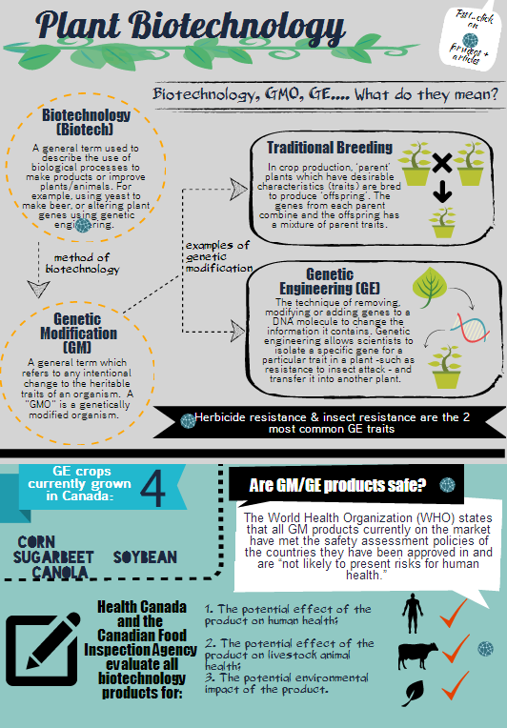
Let’s get the...
Notes:
Provide students with the Plant Biotechnology infographic and go through as a class. Outline the different types of GMO and facts on the infographic. Highlight career opportunities in GMO and ask class if they can think of any more. Talk about the role each of the outlined careers plays in plant biotech.

Slide 26
...And of Course it is important to consider YOU, the CONSUMER
Notes:
Discuss the role of a consumer. Talk about how there has been GM foods that have been rejected by consumers and taken off the market. Help students realize their role in the debate and how important it is to make informed decisions.

Slide 27
4 Corners
I feel comfortable buying and eating food that comes from genetically modified crops
Notes:
Have student’s come together and do a 4 corners activity. On each wall have “Agree, Disagree, Strongly Agree and Strongly Disagree”
Ask students to move to the corner that represents their point of view as consumers:

Slide 28
4 Corners
I think foods that have been genetically modified should be labelled
http://allaboutfood.aitc.ca/article/your-questions-about-biotechnology-answered.php
Notes:
After each question facilitate discussion and ask each group why they are standing where they are.
If time permits go to http://allaboutfood.aitc.ca/article/your-questions-about-biotechnology-answered.php and click on questions. As a class discuss each of the questions (click on a question to make it full screen display)
Finish with the idea that there are many perspectives and no right or wrong answer. It should always be a goal to look at the source and credibility of a statement before taking all you hear as truth. Also discuss the possibility of looking at GMOs on a case by case basis and not treat all scenarios the same.

